Slide 1

MARKET RESEARCH

Slide 2

Identify words relevant to market research from the word cloud

Slide 3

Why is market research needed?
How is it carried out?
Write your answers on Collaboration Board of Nearpod (2 minutes)

Slide 4
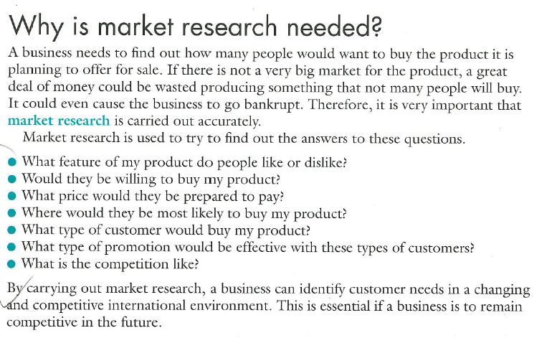
Why is market research needed?

Slide 5
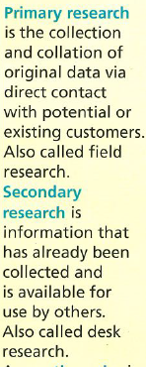
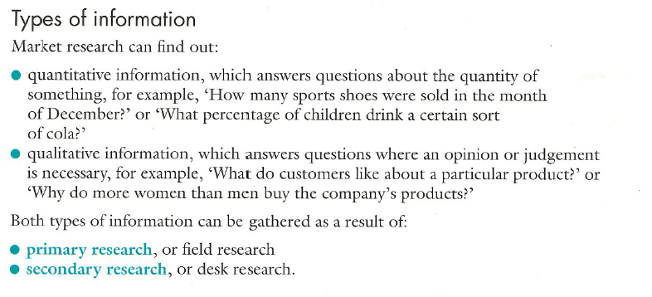

Slide 6
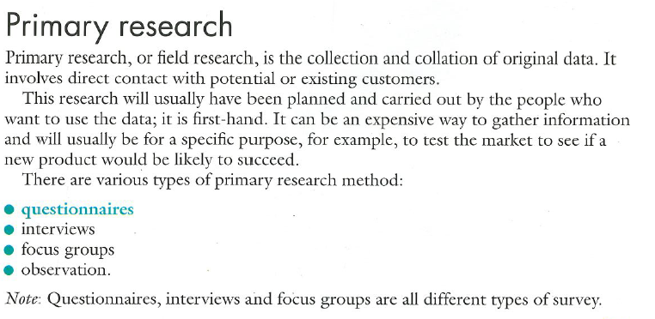
PRIMARY RESEARCH
Learning Outcomes:
Define Primary Research
Identify different techniques of primary research

Slide 7
Learning Outcome:
Explain the process of carrying out primary research

Slide 8
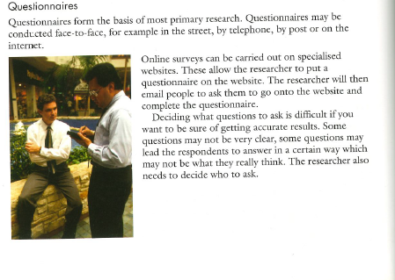
Questionnaires

Slide 9
Learning Objective:
To be able to analyse different techniques of primary research ( Criterion B)
Learning Outcomes: Students can -
Define Primary Research
Identify different techniques of primary research
Explain the process of carrying out primary research
Extension 1: Create a Questionnaire
Extension 2: Evaluate questionnaires as a technique of primary research

Slide 10
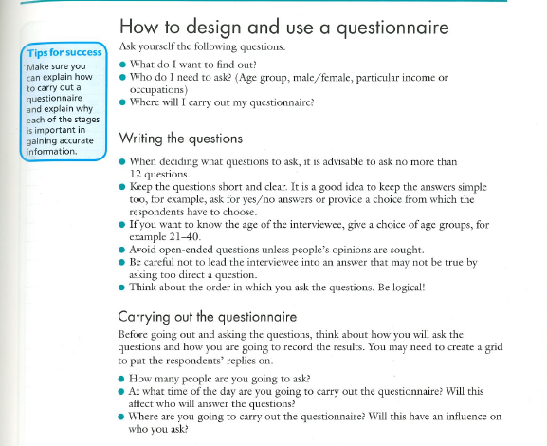

Group Task:
You have recently completed the topic market structures. Create a questionnaire on impact of the current market structure of telecommunication market of UAE on the consumers.
OR
Group Task:
Create a questionnaire on feasibility of opening a new restaurant in your local area.
You can use google forms or any other online tool to create questionnaires.
Post your sample questionnaire image on padlet link:
https://padlet.com/palakm/sujbxhgxhe1ra27i
Upload your questionnaire link on collaboration space. Ask your peers to fill your questionnaire.
Extension Outcome 1:
Create Questionnaires

Slide 11
Based on the responses that you got from your questionnaire, collate the data.
What other possible questions you could have added to strengthen your questionnaire?
What are the key qualities of a good questionnaire in your opinion? Write your answer on nearpod collaboration board.
Analyse advantages and disadvantages of questionnaires.
Learning Outcome:
Extension 2: Evaluate questionnaires as a technique of primary research

Slide 12
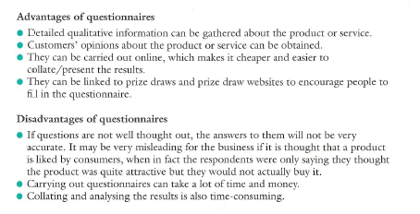
Advantages and Disadvantages of Market Research

Slide 13
Warm up: One thing we will all experience at some point in our life is a job interview. Here is a list of 7 common questions from U.S. News and World Report.
You are giving your dream job interview. Answer these questions in nearpod collaboration board. (10 minutes)
Tell me about yourself.
How did you find out about the position?
What interests you about this job?
Have you used our product/service?
What's your greatest strength?
What's your greatest weakness?
What salary range are you looking for?

Slide 14


Interviews
Learning Outcome:
State the generic process of carrying out an interview
Tips to conduct interviews:
https://www.youtube.com/watch?v=nw9TOjyCWiM
What do you think are advantages and disadvantages of interviews. Write your answers in nearpod collaboration board.

Slide 15
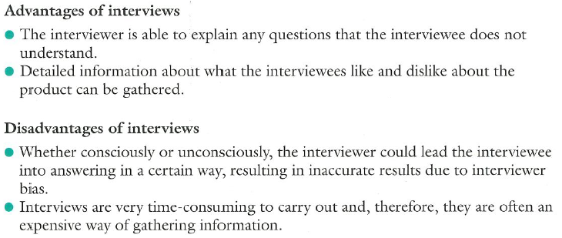
Learning Ouctome:
Evaluate interviews and focus groups

Slide 16
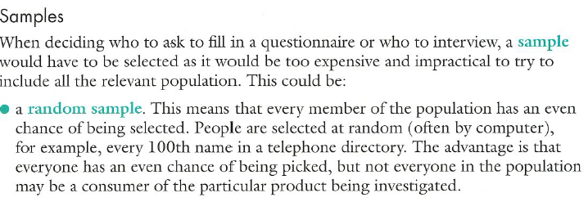
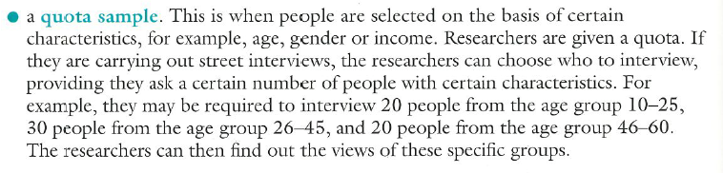
Samples
Learning Outcome:
Explain samples and focus groups as techniques of primary research

Slide 17
Learning Objective:
To be able to analyse interviews, samples, observations and focus groups as techniques of primary research ( Criterion B)
Learning Outcomes: Students can -
State the generic process of carrying out an interview
Explain samples, focus groups and observations as techniques of primary research
Evaluate interviews, focus groups and observations
Extension : Create a Mock Interview

Slide 18
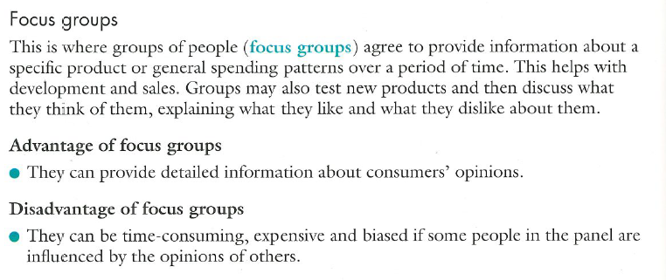
FOCUS GROUPS
Learning Outcome:
Explain samples and focus groups as techniques of primary research
Evaluate interviews and focus groups

Slide 19
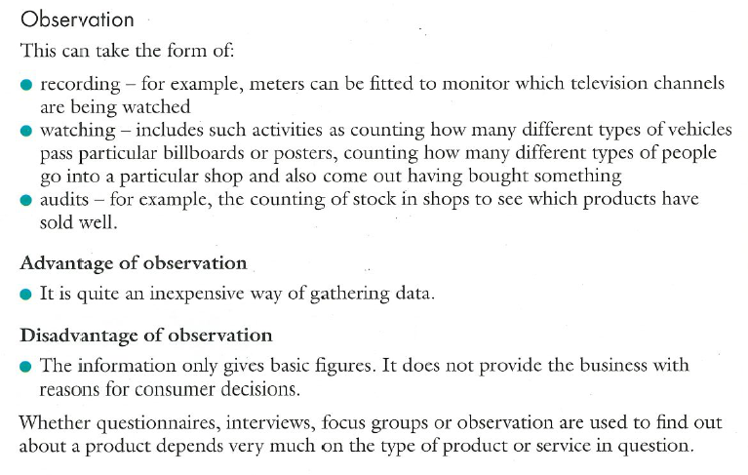
Observations
Learning Outcomes:
Explain samples, focus groups and observations as techniques of primary research
Evaluate interviews, focus groups and observations

Slide 20
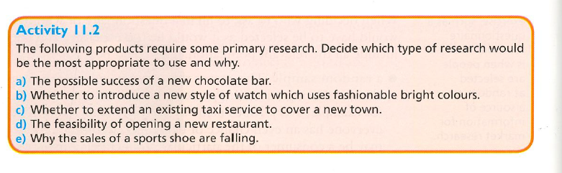
Fun Activity – Type your answers on nearpod collaboration space

Slide 21
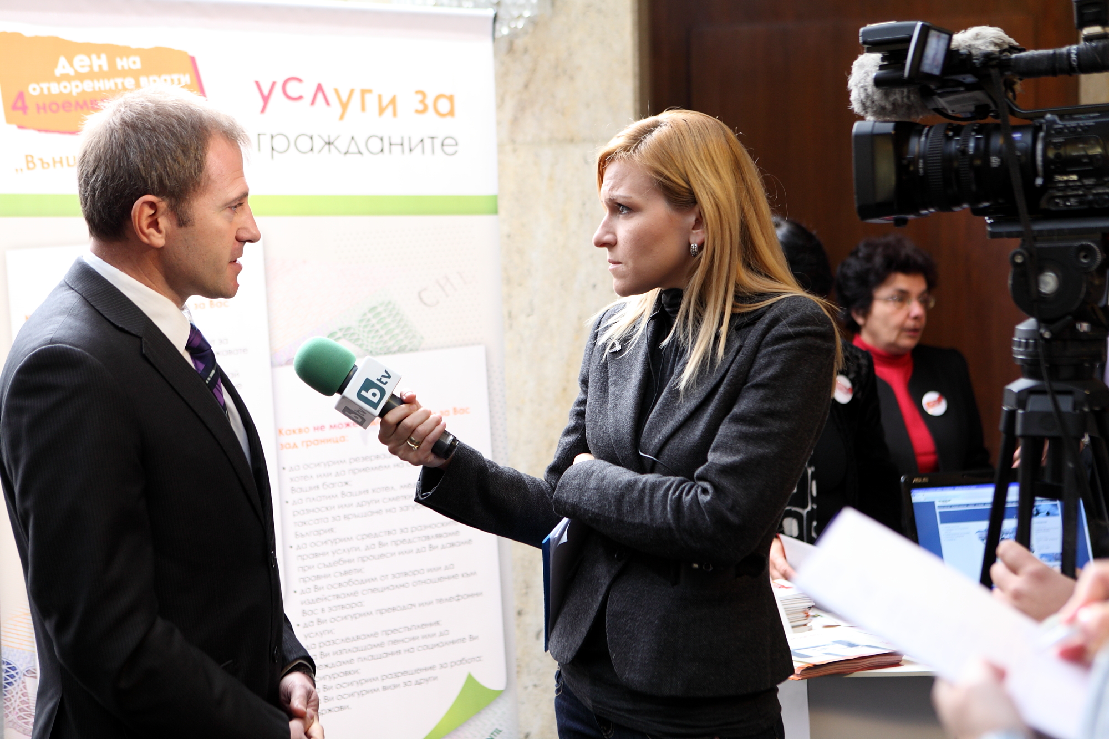
Create a mock interview: Upload your work on padlet
Extension:
Create a mock interview
You all eventually need to give interviews for your universities. Create an audio recording or a video of a university mock interview. You and your partner will take turns answering and asking questions. When you are asking the questions feel free to encourage your partner to elaborate more if necesssary. You will be evaluated on the following criteria: delivery (eye contact/posture/volume), quality of response, video: appearance. You can use flipgrid to record your videos.
Group 1:
Garv , Nimit , Amandine
Group 2:
Mariasole
Muhammad Araiz
Atlas
Group 3:
Mohamad, Hreem, Yagiz, Samaira
Watch the below video. What other questions the host could have asked Donald trump.
https://youtu.be/Xb7jWw5lft4
You need to interview Financial Minister of UAE on how he plans to promote economic growth amidst the pandemic. Create interview questions for Finance Minister of UAE.
Hint: You can refer to new strategies that UAE government in implementing to support economic growth.

